Slide 1
Continuous Integration
Slides adapted from Prof. Chris Parnin/NCSU

Slide 2
Motivation
“Modules that worked individually were put together and the whole usually failed in ways that were infuriatingly difficult to find. Yet in the last few years, integration has largely vanished as a source of pain for projects, diminishing to a nonevent”
IEEE Software paper in 2003, 27% companies surveyed run daily builds.
State of Agile, 2013, 69% automated build, 57% use continuous integration tools.

Slide 3
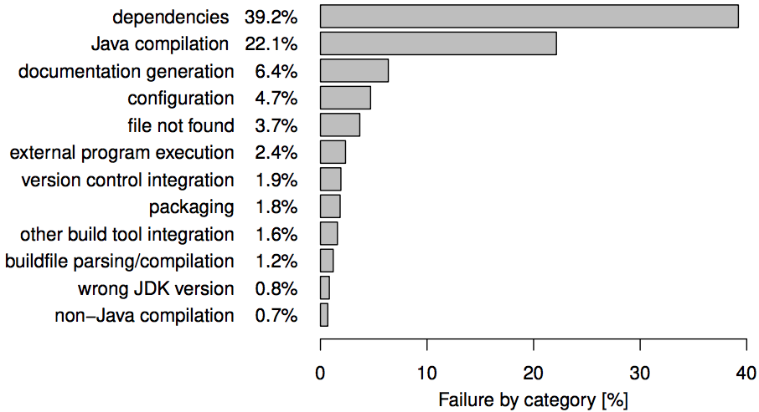
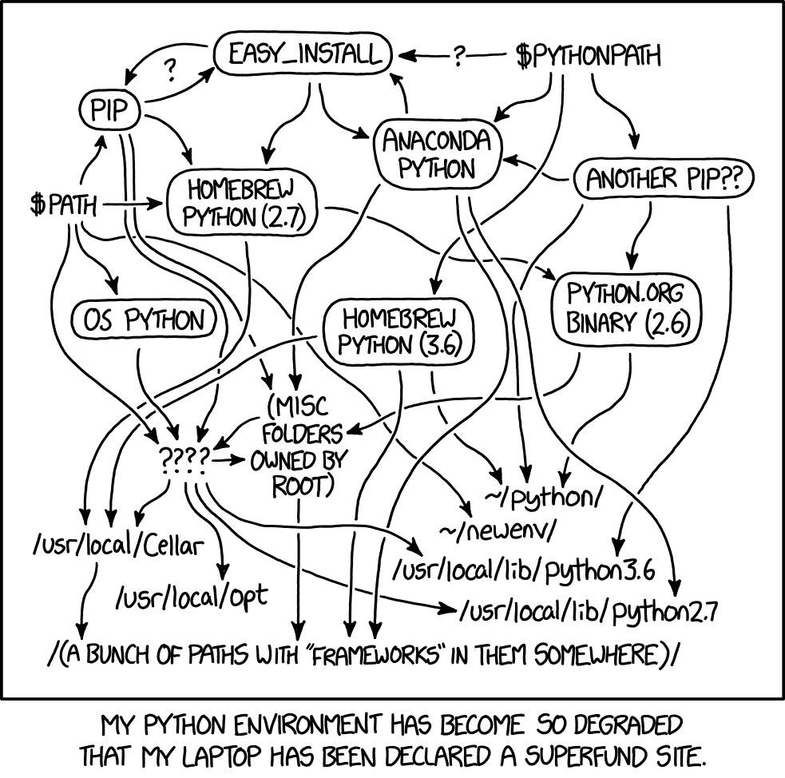
Dependencies
A Quantitative Study of Java Software Buildability
https://sulir.github.io/papers/Sulir16quantitative.pdf

Slide 4
Practice
Continuous integration: A practice where developers automatically build, test, and analyze a software change in response to every software change committed to the source repository. A continuous integration server monitors the status of every commit and reports any problems.
Configuration Management is the legacy process prior to CI, but still many of the concepts have been explored, just done manually or without tool support. We see these things come back, with mobile software (device fragmentation).

Slide 5
CI - What does it really mean?
At a regular frequency (ideally at every commit), the system is:
Integrated
All changes up until that point are combined into the project
Built
The code is compiled into an executable or package
Tested
Automated test suites are run
Archived
Versioned and stored so it can be distributed as is, if desired
Deployed
Loaded onto a system where the developers can interact with it

Slide 6
Claimed Benefits
Detecting defects and fixing them faster
Health of software is measurable
Reduce assumptions about environment
Reducing repetitive processes saves time, costs, and effort
CI can enable you to release deployable software at any point in time.
CI offers a global mechanism for feedback about failure, enabling developers to have more confidence in making their changes.

Slide 7
Principles
Commit Code Frequently
Don’t commit broken code
Fix broken builds immediately
Write automated developer tools
All tests and inspections must pass
Run private builds
Avoid getting broken code

Slide 8
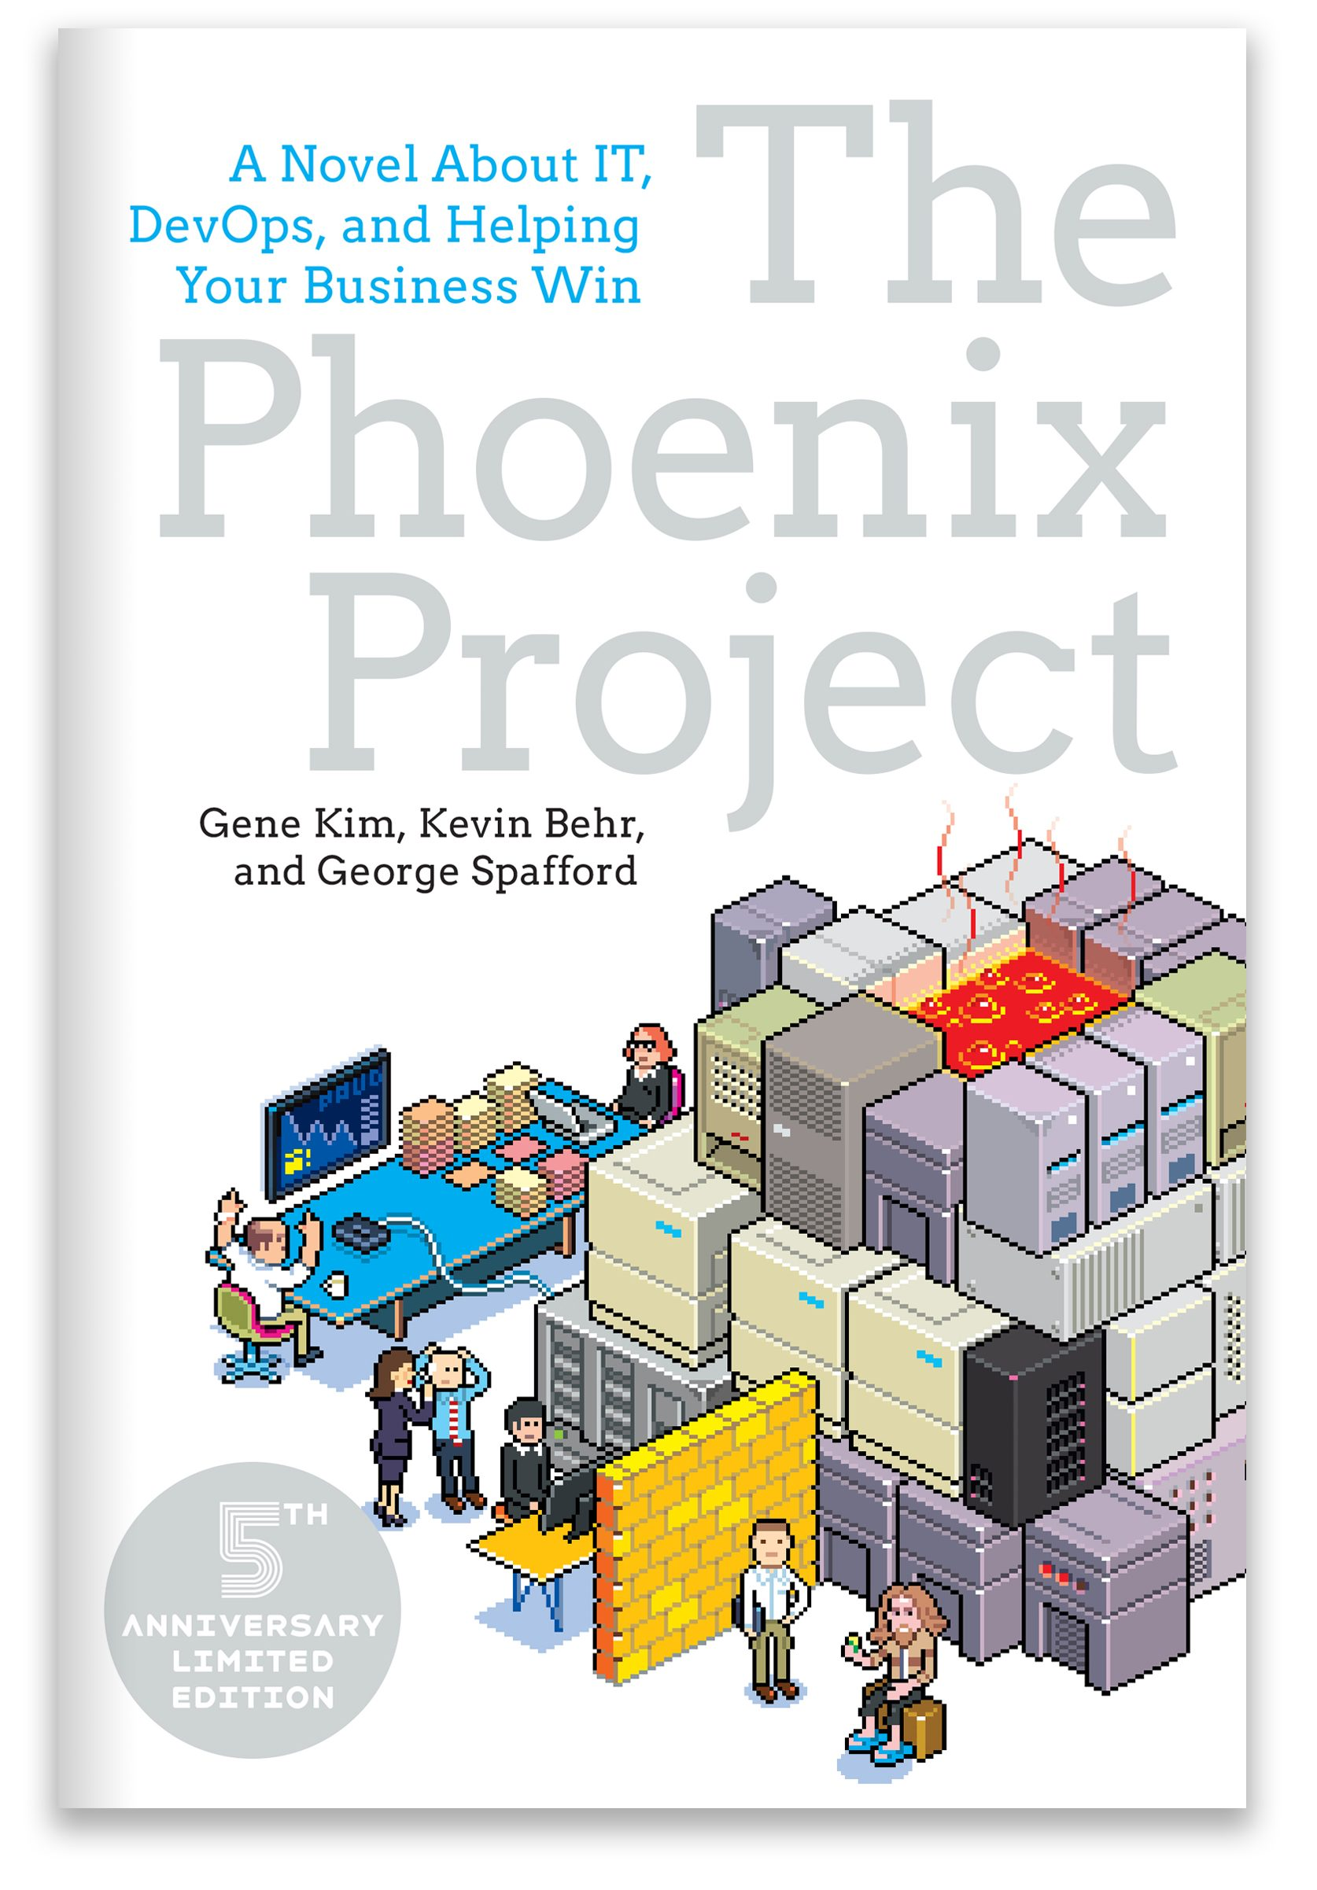
Activity
Share your experiences with using CI during a job or internship.
Name a positive benefit.
Name a problem.
https://itrevolution.com/book/the-phoenix-project/

Slide 9
Additional Barriers
“My project has seven billion lines of code. How will this work for me”
“I have a legacy application, so how can I transition”
“What if our source code is in multiple version control repositories”
“Our project is separated geographically, so how can we practice CI”
“My integration builds are taking too long”
“We frequently get build failures. Are we doing something wrong?”
“We can’t afford a separate build machine [infrastructure].
“Our software is too complex; we have to do things manually”
“Our software uses a version control repository, but we need to support multiple versions using branching. How will this work?”
Continuous Integration (CI) Needs and Wishes for Developers of Proprietary Code - ICSE’17

Slide 10
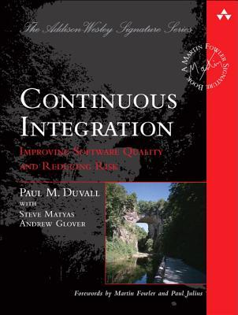
Why CI is not enough
Concept of deployment is very simple
Database integration conceptualized as “dropping database” and “recreating with scripts”
A handful of servers (web server, db)
Complex deployment infrastructure and living data and users not accounted for
Cache services, eventual consistency, loader balancers
Dated: Concepts emerging in 1999-2005, book published in 2007.

Slide 11
Build Teams
Build teams take over the role of building software.
Can serve as gatekeepers on code integration.
Create build configuration and sometimes verification scripts
Putting out fires, helping with build failures
Understanding and Improving Software Build Teams - ICSE 2014

Slide 12
Build Servers
Infrastructure for automating building software in an isolated environment.
Typical workflow:
Checkout
Execute Build Manager (Ant/Maven/etc.)
Validate, Test, Notify, Publish Results

Slide 13
What are the problems?
For each stage: Build, Test, Deploy….must deal with related tools, including:
All possible/popular langauges
Ant, Make, Maven, Gradle…
Findbugs, CheckStyle, Lint,…
Cobertura, Jlint….
Docker, Vagrant…
Must deal with failures and recover as needed (Why?)
Must properly wait for things to be done (Why?)
Must Start Automatically when appropriate (Why?)
Must notify humans as and when appropriate (Why?)

Slide 14
Beyond?
Continuous Delivery
Continuous Deployment
Configuration Management (Thursday Lecture)
Source: Shahin, M., Zahedi, M., Babar, M. A., & Zhu, L. (2018). An empirical study of architecting for continuous delivery and deployment.
Empirical Software Engineering, 24(3), 1061-1108. https://doi.org/10.1007/s10664-018-9651-4
Notes:
Continuous Delivery
Develop to release at any time
Continuous Deployment
Deploy new features immediately
Production environment is where the applications or services are available for end users;
Staging environment aims at simulating the production environment as closely as possible

Slide 15
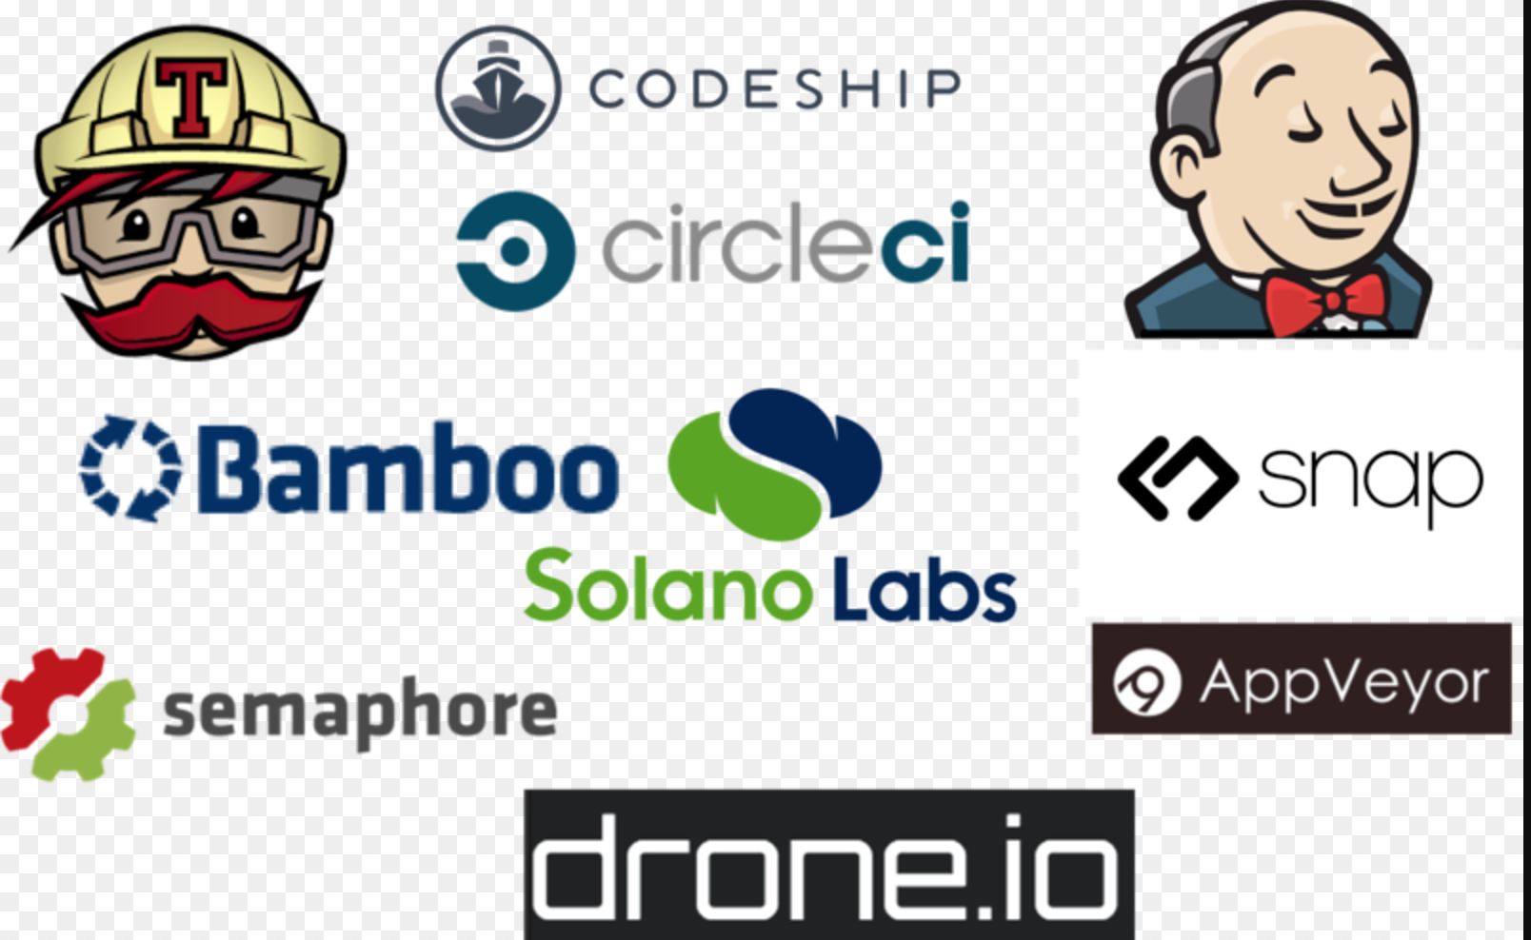
Lots of Tools available

Slide 16
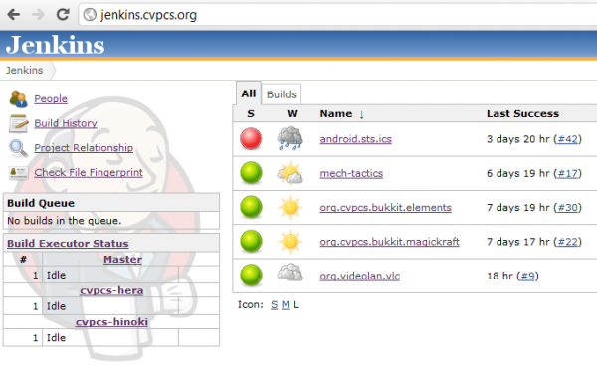
What does Jenkins do
Continuously builds newly checked-in code.
Runs unit tests and other validation; rejects builds on failure.
Can deploy code to servers or perform other post-build steps.
Also provides
Reports on build failures
Provides build history
Status and reports
on code quality, unit tests, etc.

Slide 17
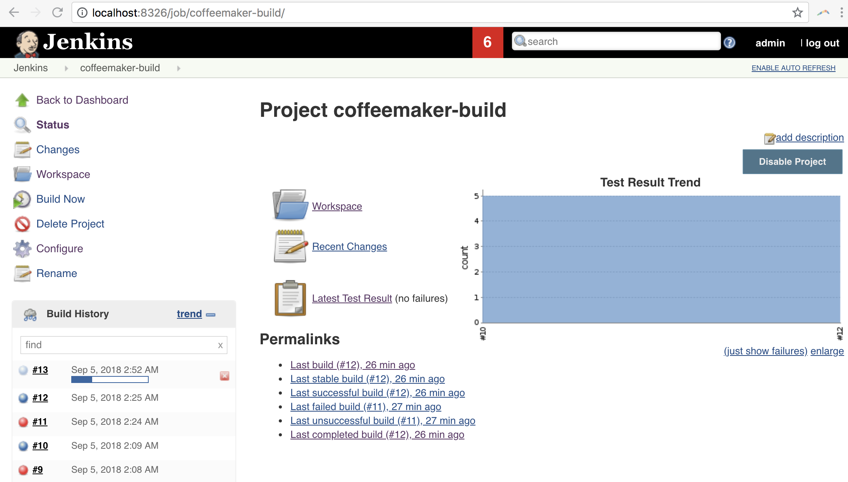
https://github.com/ottomatica/baker-examples/tree/master/jenkins

Slide 18
Core concept: a PIPELINE.
TYPICAL PIPELINE:
Checkout
Build/Test
Publish test results & code coverage
CodeSonar Static code analysis
Create Docker image for deployment
Deploy and Run system test

Slide 19
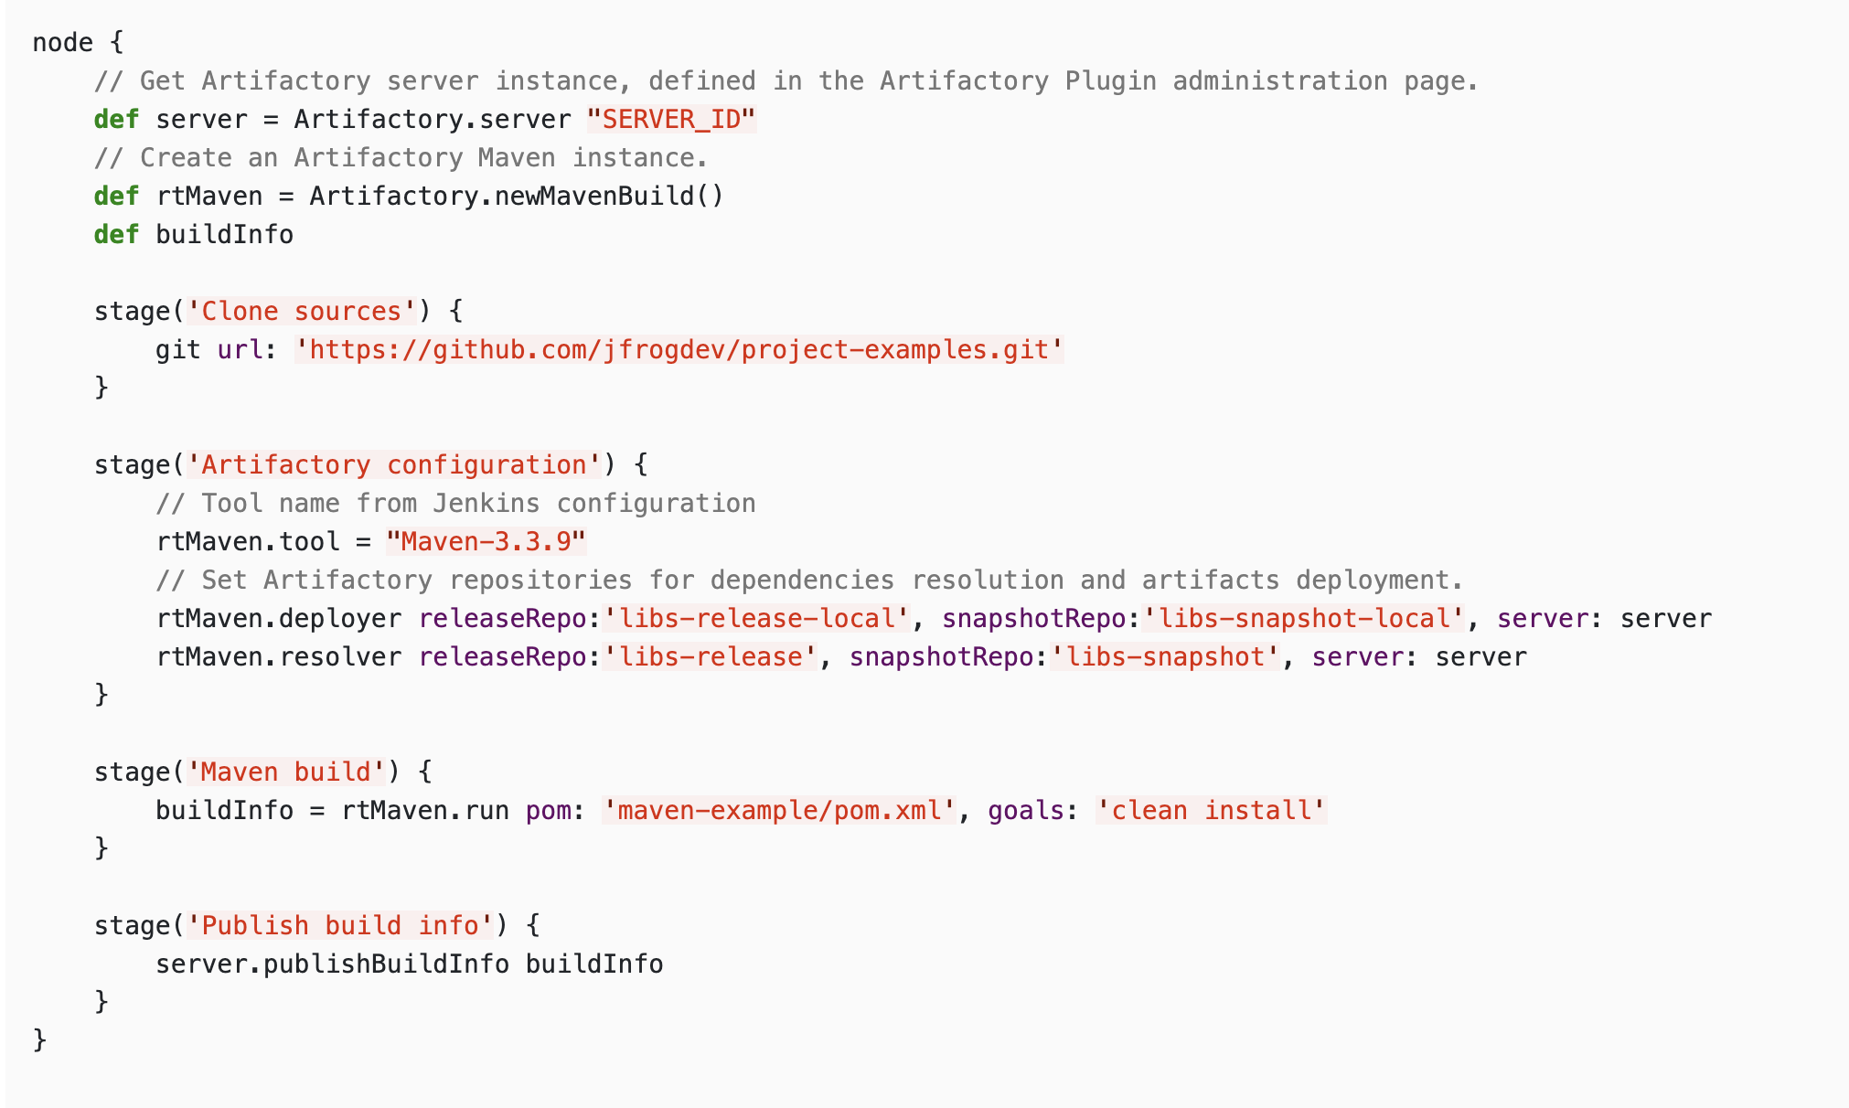
Jenkins Job Builder
Jenkins Pipelines
<?xml version="1.0" encoding="utf-8"?>
<project>
<scm class="hudson.plugins.git.GitSCM">
<configVersion>2</configVersion>
<userRemoteConfigs>
<hudson.plugins.git.UserRemoteConfig>
<name>origin</name>
<refspec>+refs/heads/*:refs/remotes/origin/*</refspec>
<url>https://github.com/openstack-infra/jenkins-job-builder.git</url>
<credentialsId>43ed1990-46e5-4ed0-bfda-8d83e5cdd65f</credentialsId>
</hudson.plugins.git.UserRemoteConfig>
</userRemoteConfigs>
<branches>
<hudson.plugins.git.BranchSpec>
<name>master</name>
</hudson.plugins.git.BranchSpec>
</branches>
<disableSubmodules>false</disableSubmodules>
<recursiveSubmodules>false</recursiveSubmodules>
<doGenerateSubmoduleConfigurations>false</doGenerateSubmoduleConfigurations>
<remotePoll>false</remotePoll>
<gitTool>Default</gitTool>
<submoduleCfg class="list"/>
<reference/>
<gitConfigName/>
<gitConfigEmail/>
<extensions>
<hudson.plugins.git.extensions.impl.CleanCheckout/>
<hudson.plugins.git.extensions.impl.CloneOption>
<shallow>true</shallow>
</hudson.plugins.git.extensions.impl.CloneOption>
<hudson.plugins.git.extensions.impl.WipeWorkspace/>
</extensions>
</scm>
</project>
scm:
- git:
url: https://github.com/openstack-infra/jenkins-job-builder.git
credentials-id: "43ed1990-46e5-4ed0-bfda-8d83e5cdd65f"
branches:
- master
clean: true
shallow-clone: true

Slide 20
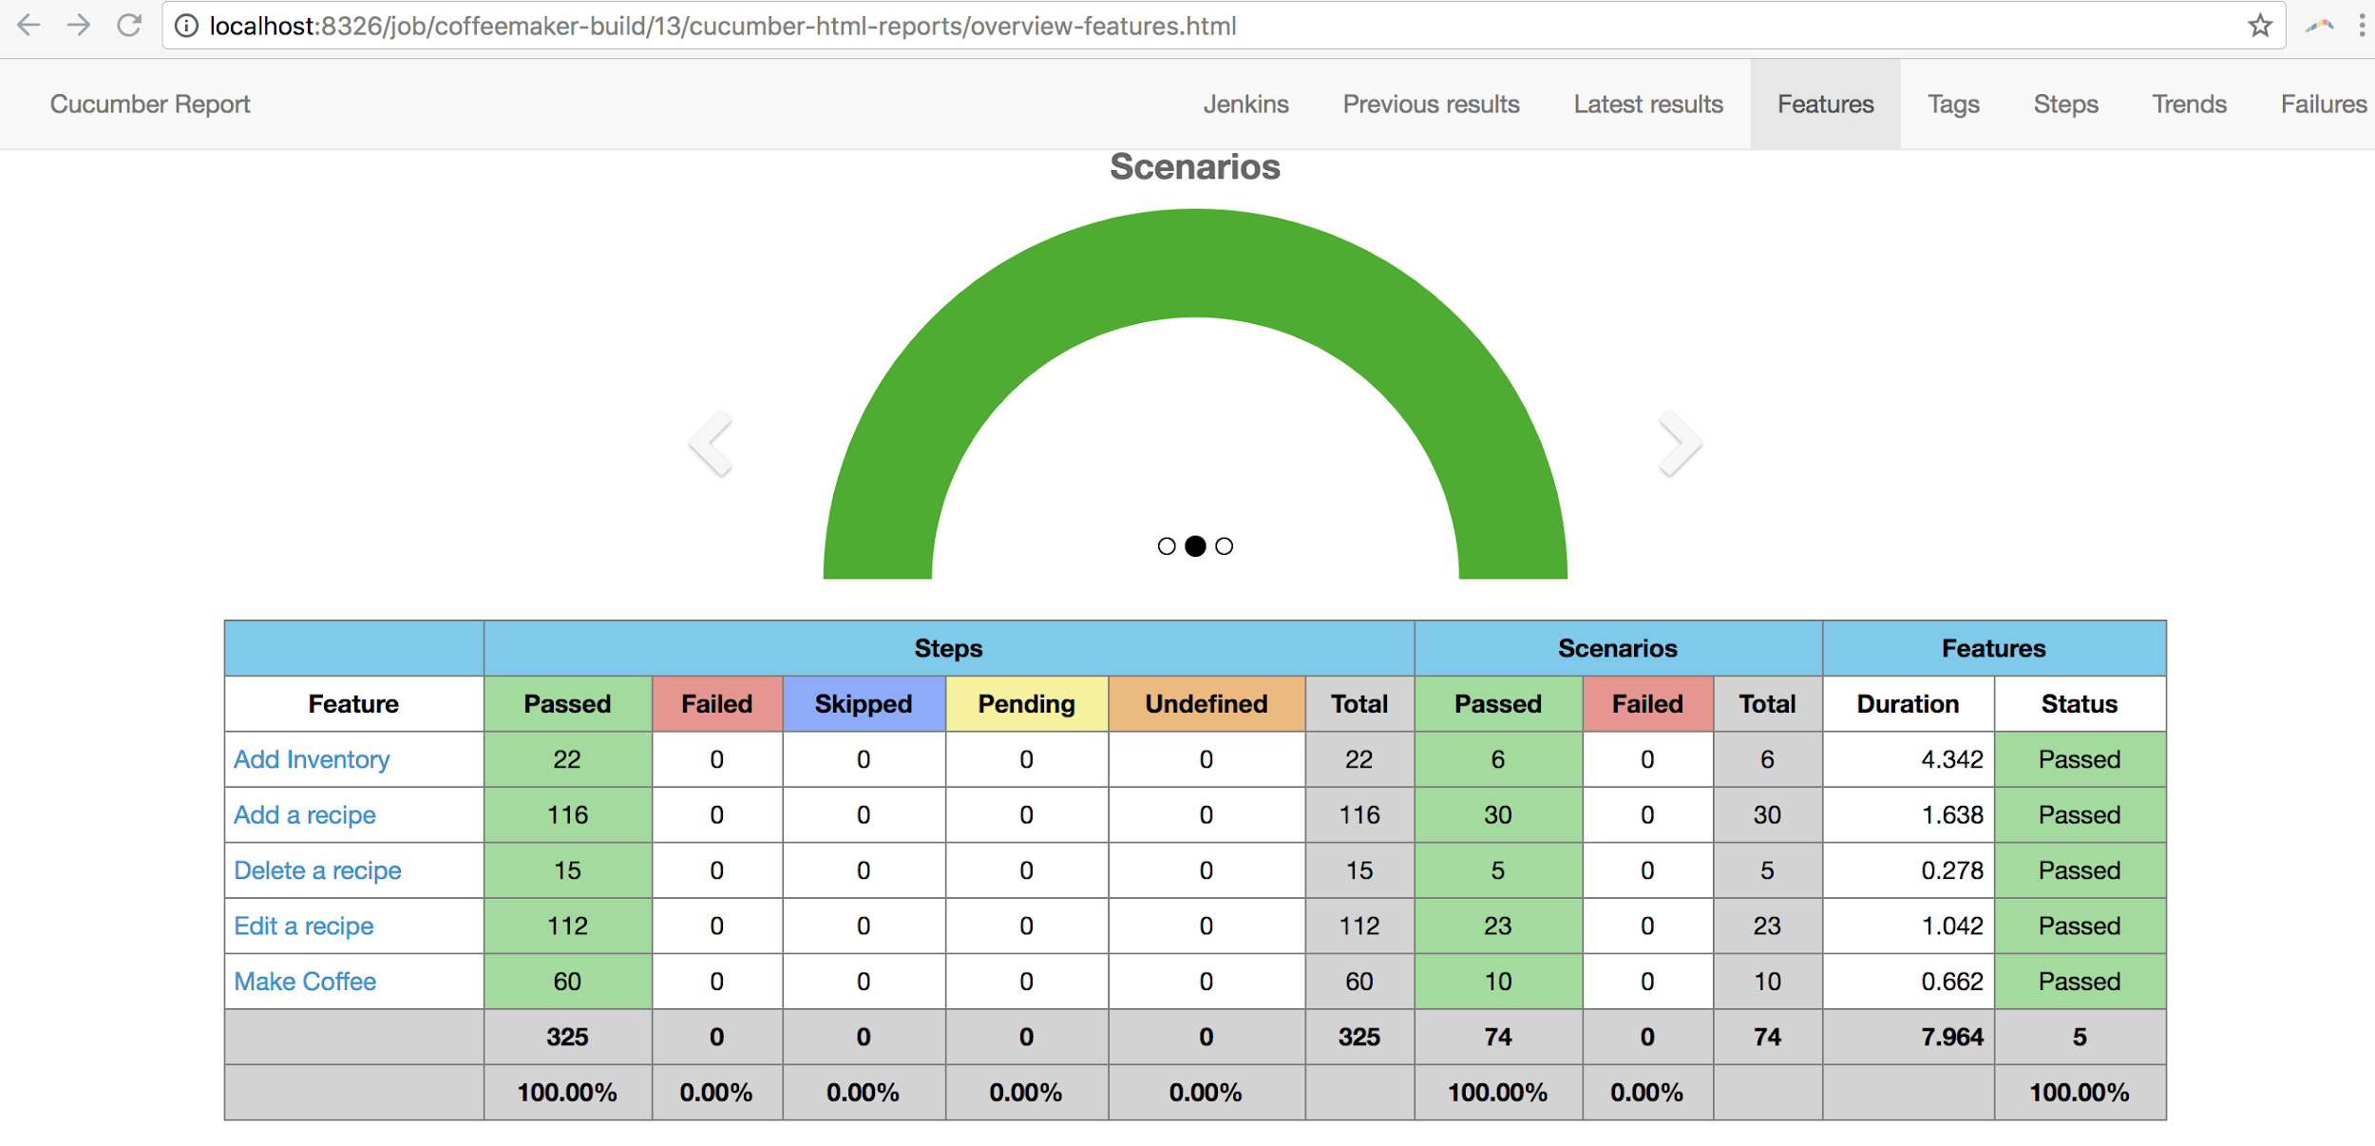
Reports

Slide 21
Issues
Project can take hours to build.
Bad state
Sometimes build jobs leave side-effects which need to be manually cleared.
High memory usage or memory leaks in unit testing code can exceed server memory and melt… needing frequent restarts.
High volume of build requests…
Executors can help, which will run jobs on slave servers.

Slide 22
Travis
Different from Jenkins:
You run Jenkins yourself, on your own machine.
Travis is Continuous Integration as a Service. They do it for you.
Integrated with GitHub.
Automatically triggered by pushes or pull requests, according to project rules
Executes as configured by a travis.yml file. NOTHING TO INSTALL!!! YEAH!

Slide 23
Travis concepts.
Travis executes BUILDS.
Builds are composed of JOBS. (e.g., compile, install, deploy, testing with multiple version of python).
Each JOB can have many PHASES (e.g., install, test, deploy).

Slide 24
Travis is compatible…
Integrated with Ruby, Python, Java, node.js etc..
Works with all major build systems: Ant, Maven, Gradle…
Can work with Containers, or Virtual Machines.
Has built-in support for Parallelism.

Slide 25
Use of Travis for Collaboration
Travis is integrated with GitHub
Travis “Plays Nicely” with the pull-request model.
Travis can help scale up Open-source software teams, and manage many, many, contributions from many, many, developers.

Slide 26

CI as gatekeeper
https://commons.wikimedia.org/wiki/File:City_Park_NOLA_4_July_2010_Garden_Gate.JPG

Slide 27
“[CI] enables us to automate more of our process which frees us up to focus on the important things — like implementing and shipping features! […]
[The integration of Travis-CI in GitHub] enables the team to rapidly find integration errors or regression failures in the test suite. This tightens the feedback loop and not only enables more defect free code, but greatly speeds up our process.”
Automate All The Things: Continuous Integration and Deployment at RevUnit
Addam Hardy. http://addamhardy.com/blog/2013/09/28/automate-all-the-things-continuous-integration-and-continuous-deployment-at-revunit/

Slide 28
Summary
CI Tools manage Build, Test, and Deploy phases for DevOps
These tools must manage failures, delays, parallelization, scheduling, operator notification & interaction, and deal many different types of languages, tools etc.
Jenkins is a “own and operate” example.
Travis provides CI as a Service (DevOps or no DevOps).
Travis integrates with GitHub, and helps Open Source projects manage scale.

